Slide 1

AI-POWERED HANDWRITTEN ANSWER SHEET EVALUATION SYSTEM
by
R.LIKHITHA
Roll No. 224G1A0541
M.SUNITHA
Roll No. 224G1A05B0
P.PRATHIBHA
Roll No. 224G1A0575
Under the guidance of
Mr. C. Sudheer Kumar, M.Tech, (Ph.D)
Assistant Professor
Department of Computer Science and Engineering
Srinivasa Ramanujan Institute of Technology
Autonomous
Rotarypuram Village, B K Samudram Mandal, Ananthapuramu – 515701.
Accredited by NBA & NAAC with “A” Grade,Affiliated to JNTUA,Ananthapuramu
2025-2026

Slide 2
Comments
What is the difference between the existing college evaluation system and our project?
Have you referred to any research papers for this project?

Slide 3

Contents
Abstract
Introduction
Literature Survey
Existing System
Proposed System
Planning
Design
Implementation
Research Paper
References
GitHub Link

Slide 4
Abstract
Introduction: Manual evaluation of handwritten answer sheets is time-consuming and may lead to inconsistency and human error.
Research Gap: Existing systems focus on digital or keyword-based evaluation and lack accurate assessment of handwritten descriptive answers.
Methodology Used: Handwritten answers are scanned, converted to text using OCR, and evaluated using AI techniques by comparing them with model answers.
Result: The system provides faster evaluation with improved accuracy and consistent marking compared to manual correction.
Conclusion: The proposed system reduces teacher workload and enables fair, automated answer sheet evaluation for educational institutions.

Slide 5
Introduction
The AI-Powered Handwritten Answer Sheet Evaluation System is designed to automatically evaluate handwritten student answers using Artificial Intelligence, reducing the need for manual correction.
Manual evaluation of answer sheets is time-consuming, requires a lot of effort from teachers, and may result in inconsistent or biased marking.
With the increasing number of students and exams, there is a strong need for an automated, accurate, and fair evaluation system that can handle handwritten answers efficiently.
The project aims to improve evaluation speed, accuracy, and consistency while reducing the workload on educators.

Slide 6
Literature Survey
Author(s) | Year | Methodology Used | Implementation | Limitations
Bansal, S., Gupta, V., Gupta, E., & Garg, P. | 2025 | Deep learning–based handwritten answer evaluation using transformer-based language models and semantic similarity techniques. | The study implemented a DeepSeek-based framework to evaluate handwritten answers by converting them into digital text and comparing them with reference answers using deep neural language representations. | The system depends heavily on accurate handwriting recognition; errors in text extraction may affect grading accuracy and scalability in large datasets.
Kortemeyer, G., Caspar, A., & Horica, D. | 2025 | Artificial intelligence–assisted grading using natural language understanding and automated scoring models. | The system integrates AI-based grading assistance for handwritten calculus exam components by converting responses into digital format and analyzing mathematical reasoning patterns. | The approach is limited in handling complex mathematical expressions and diagrams, and still requires human oversight for final grading verification.
Cvengros, J., & Kortemeyer, G. | 2025 | AI-assisted evaluation using machine learning models and semantic analysis for handwritten chemistry responses. | The framework processes handwritten exam responses through OCR and applies machine learning models to assess conceptual correctness in general chemistry answers. | Recognition accuracy decreases when handwriting quality is poor, and the model struggles with symbolic chemical equations and structural diagrams.
Ghadekar, P., Khanvilkar, O., Kharat, J., Joshi, K., Kulkarni, T., & Kulkarni, Y. | 2025 | Integration of Optical Character Recognition and machine learning algorithms for automated grading. | The system converts handwritten examination sheets into text using OCR and evaluates responses using machine learning classification and similarity-based scoring methods. | Keyword-based evaluation techniques may fail to capture deeper semantic meaning, resulting in reduced accuracy for descriptive answers.
Yiğiter, M., & Boduroğlu, E. | 2025 | Artificial intelligence scoring models for open-ended handwritten responses using natural language processing techniques. | The study analyzed the effectiveness of AI-based scoring systems by comparing automated evaluation results with human graders across open-ended questions. | The evaluation accuracy varies depending on answer length and writing style, and the model shows limitations in interpreting highly diverse answer expressions.

Slide 7
Existing System
Existing handwritten answer evaluation systems mainly rely on Optical Character Recognition and basic text matching techniques to convert handwritten responses into digital text and compare them with predefined answers.
Many traditional automated grading methods use keyword-based or term frequency–based similarity approaches, which focus on matching specific words rather than understanding the semantic meaning of the student’s response.
Some recent systems incorporate machine learning and natural language processing techniques to improve evaluation accuracy, but they often depend heavily on the quality of handwriting recognition and may struggle with diverse handwriting styles.
Despite these advancements, existing approaches still face challenges such as limited semantic understanding, difficulty handling paraphrased answers, lack of effective partial evaluation mechanisms, and reduced performance when handwriting quality is poor.

Slide 8
Proposed System
The proposed system introduces an AI-powered automated evaluation framework that processes handwritten answer sheets using advanced image preprocessing, handwriting recognition, and semantic text analysis techniques.
The system converts scanned handwritten answers into machine-readable text through Optical Character Recognition combined with preprocessing methods such as noise removal, binarization, and skew correction to improve recognition accuracy.
To evaluate student responses, the system applies Natural Language Processing–based semantic similarity analysis, allowing it to understand contextual meaning and compare student answers with expert-prepared model answers rather than relying on simple keyword matching.
Based on the computed similarity score, the system performs automated scoring with support for partial marking, achieving high evaluation accuracy of 98%, reducing manual grading effort, and ensuring consistent and unbiased assessment.

Slide 9
Planning
Dataset Collection Handwritten answer sheets are collected in scanned image format along with corresponding model answers prepared by subject experts. These datasets are used for training and evaluating the system.
Image Preprocessing & OCR Module The scanned answer sheets are preprocessed using image processing techniques such as noise removal, resizing, and binarization. OCR is then applied to convert handwritten text into machine-readable digital text.
NLP-Based Answer Evaluation Module The extracted text is analyzed using Natural Language Processing techniques to compare student answers with model answers. Semantic similarity scores are computed to evaluate correctness and relevance.
Scoring & Result Generation Module Based on similarity scores, the system assigns marks, including partial evaluation. The final results are generated and stored for further analysis and reporting.

Slide 10
Design
The system is designed to automatically evaluate handwritten answer sheets using Artificial Intelligence and image processing techniques.
Students upload scanned images or photos of handwritten answer sheets through the web interface.
The uploaded images are preprocessed using image enhancement and noise removal techniques to improve readability.
Optical Character Recognition (OCR) technology is used to convert handwritten text into digital text.
The extracted text is analyzed using Natural Language Processing (NLP) algorithms to understand the content of the answers.
The system compares student answers with the model answers stored in the database.

Slide 11
Design
Based on similarity and keyword matching, the system automatically assigns marks to each answer.
The results are stored in the database and displayed on the dashboard for teachers and administrators.
The system also generates performance reports and analytics to help teachers understand student performance.
The design ensures scalability, accuracy, and faster evaluation compared to traditional manual correction methods.

Slide 12
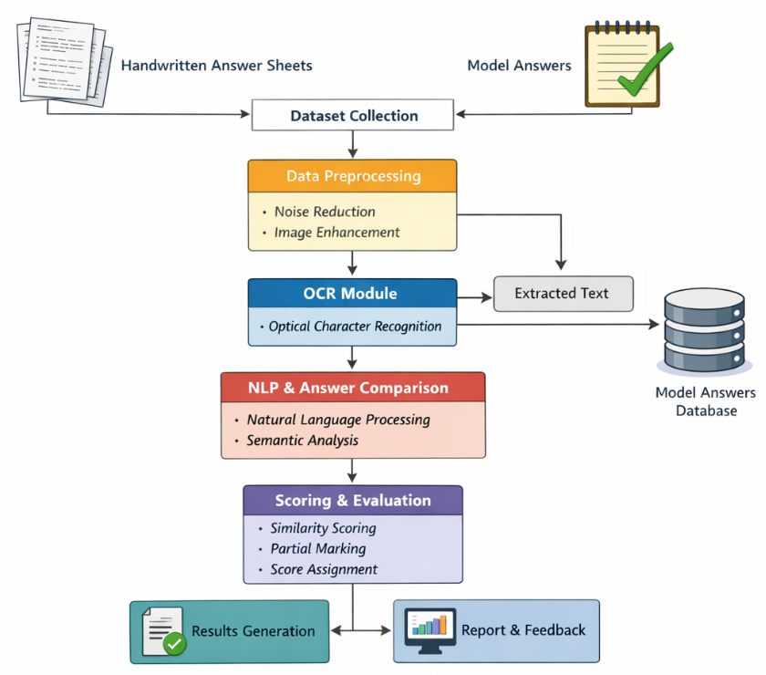
Design

Slide 13
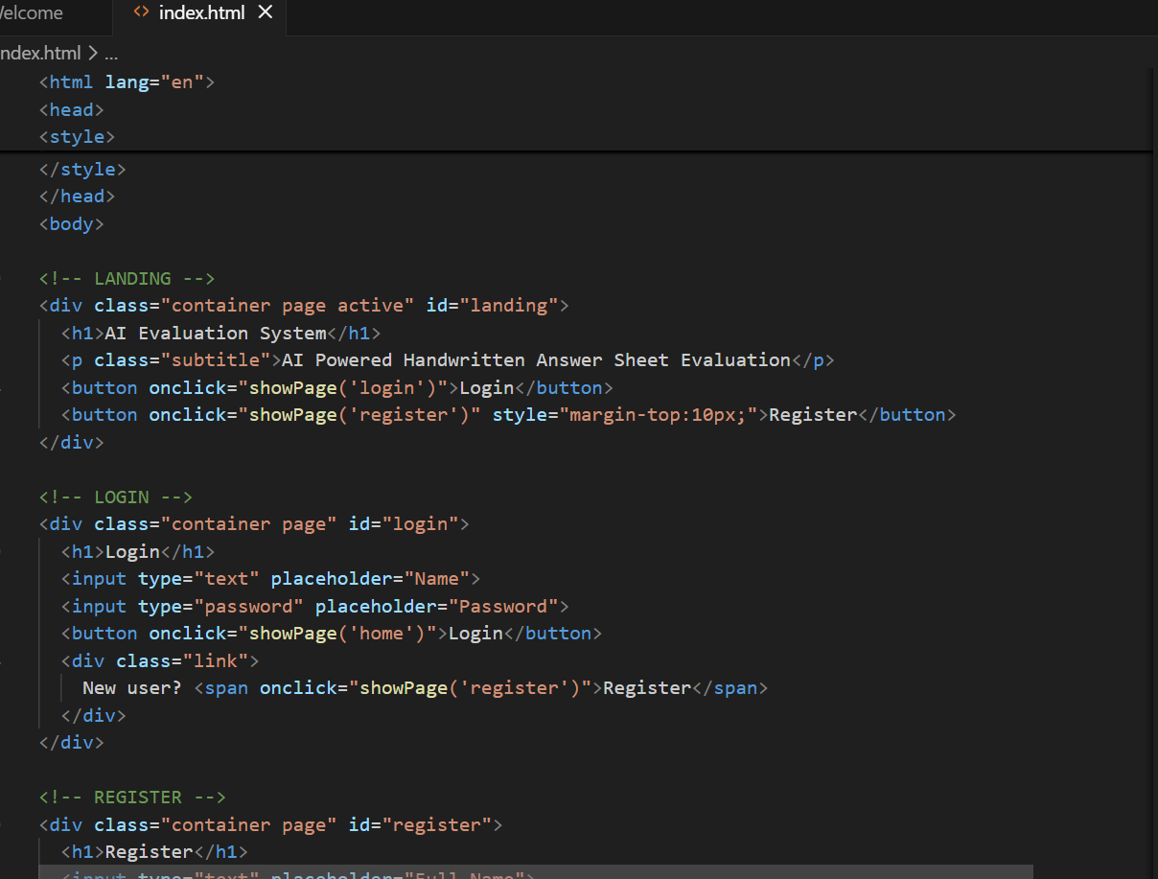
Implementation

Slide 14
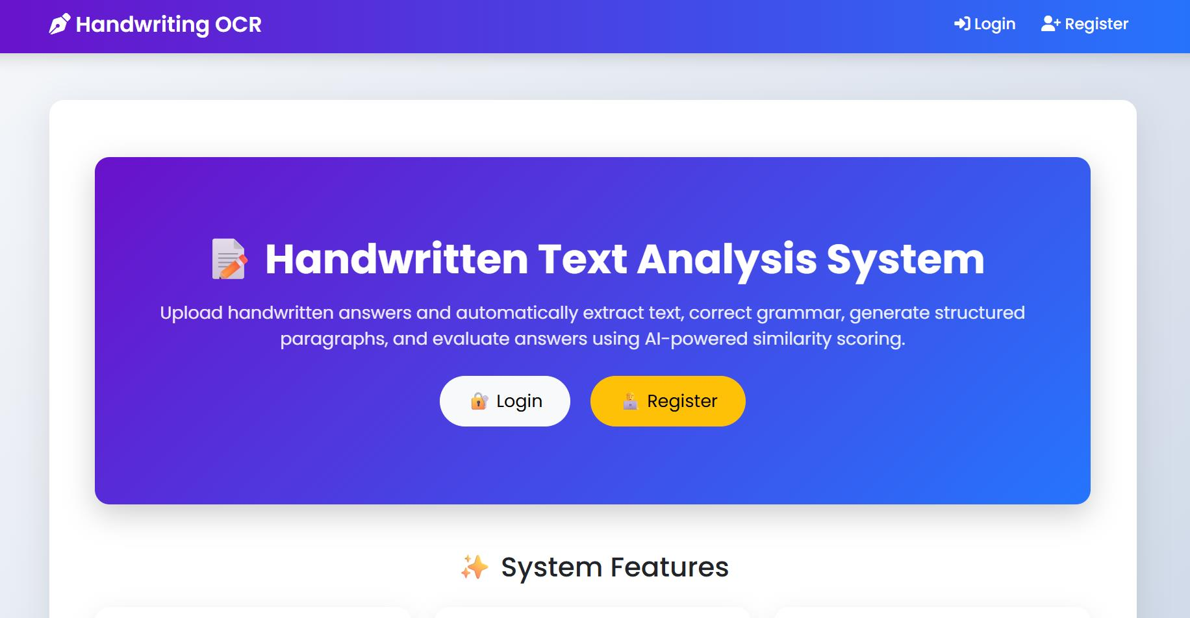
Outputs

Slide 15
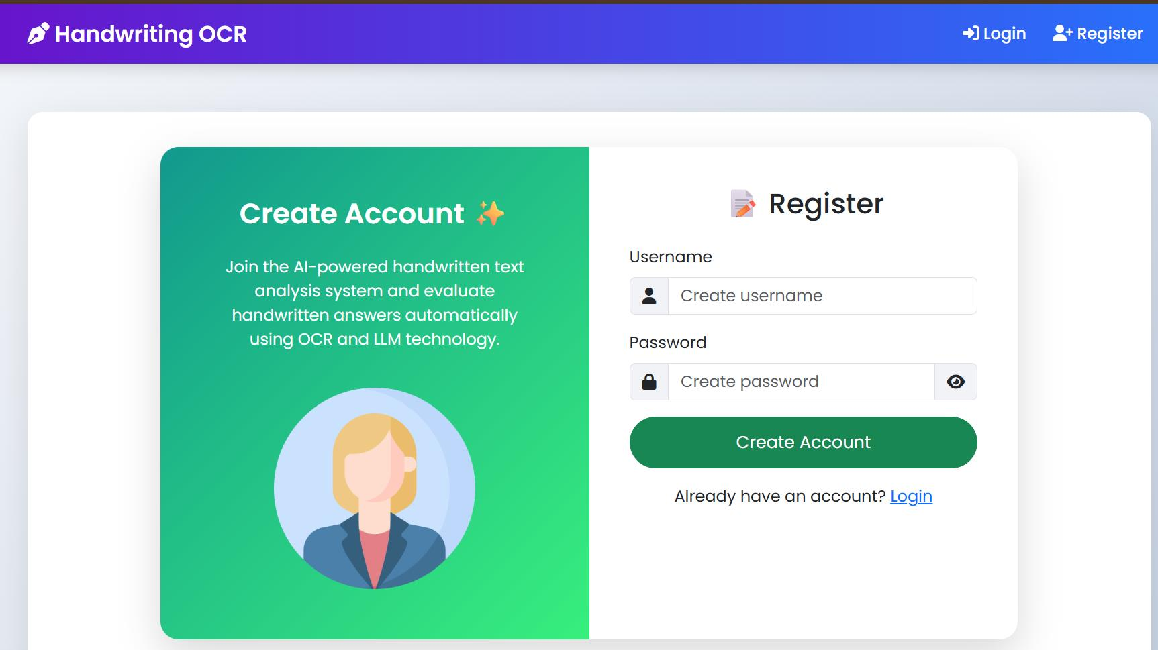
Outputs

Slide 16
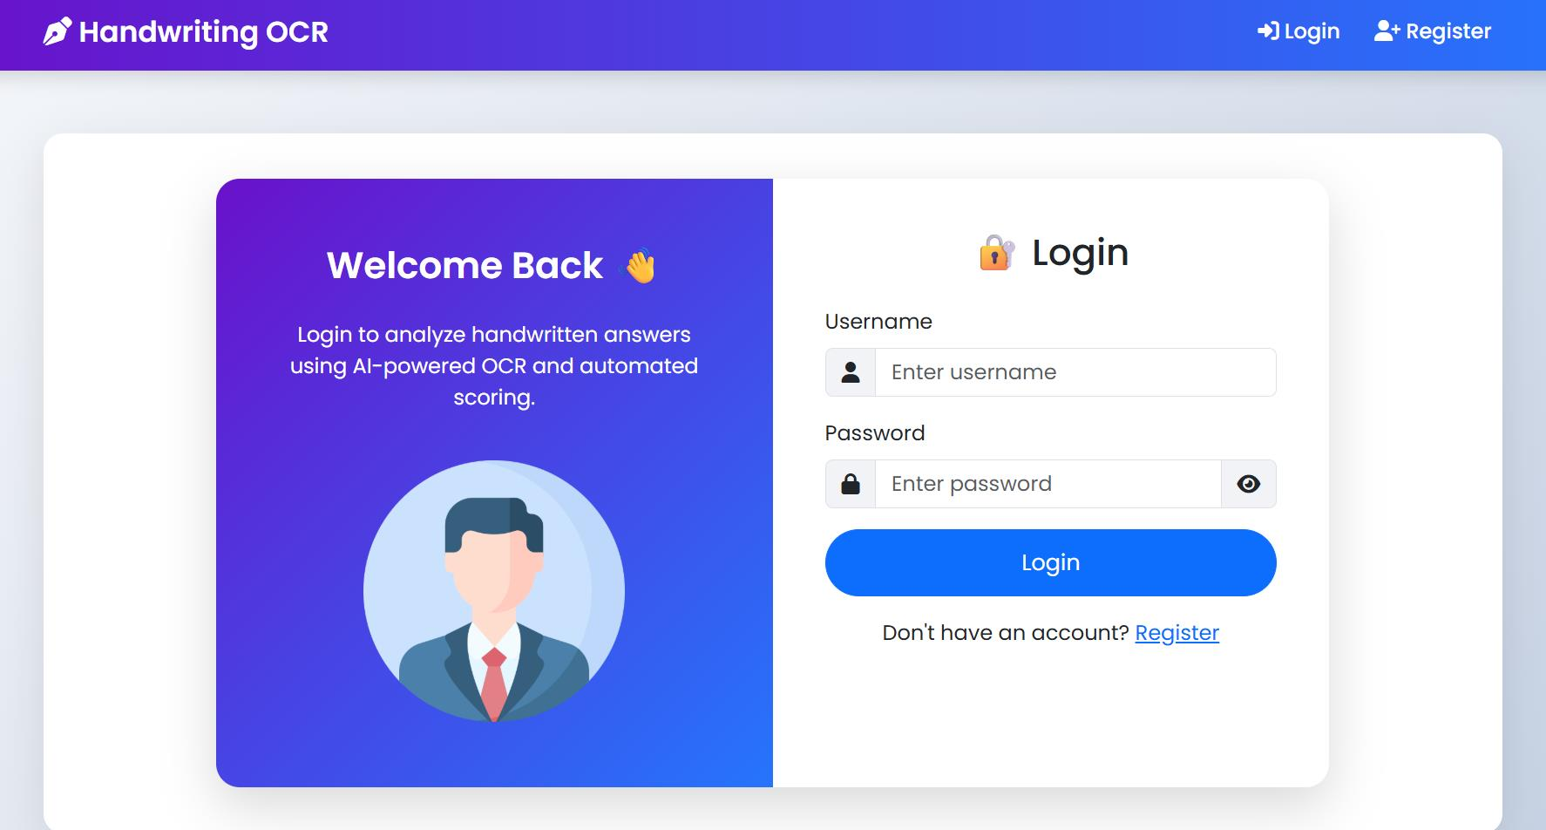
Outputs

Slide 17
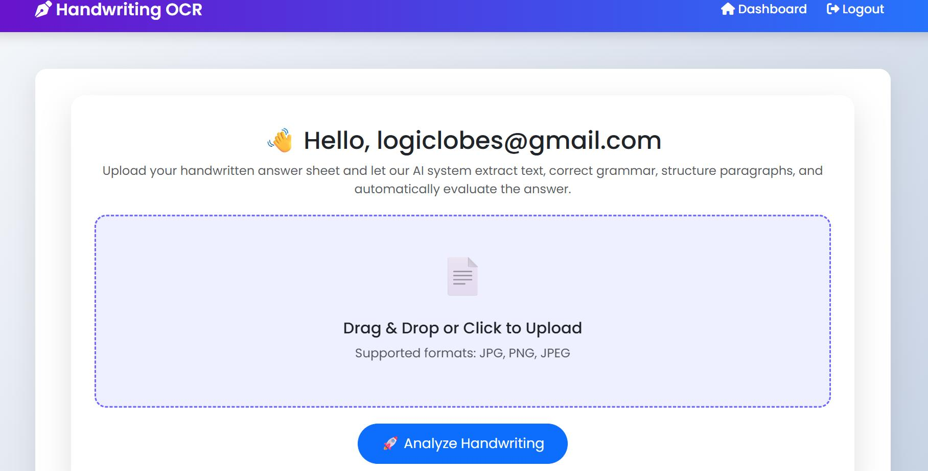
Outputs

Slide 18
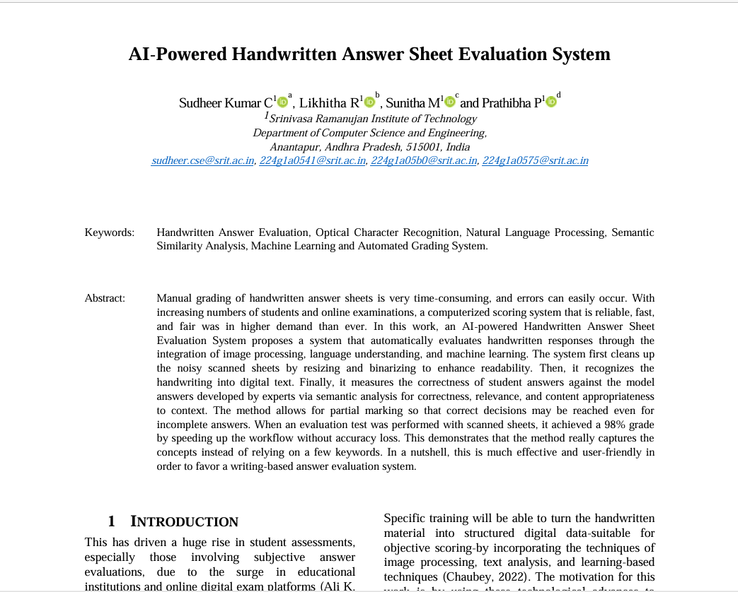
Research Paper

Slide 19
References
Bansal, S., Gupta, V., Gupta, E., & Garg, P. (2025). Evaluating Handwritten Answers Using DeepSeek: A Comparative Analysis of Deep Learning-Based Assessment. International Journal of Computational Intelligence Systems, 18(1), 209.
Kortemeyer, G., Caspar, A., & Horica, D. (2025). Artificial-Intelligence Grading Assistance for Handwritten Components of a Calculus Exam. arXiv preprint arXiv:2510.05162.
Cvengros, J., & Kortemeyer, G. (2025). Assisting the grading of a handwritten general chemistry exam with artificial intelligence. arXiv preprint arXiv:2509.10591.
Ghadekar, P., Khanvilkar, O., Kharat, J., Joshi, K., Kulkarni, T., & Kulkarni, Y. (2025). Automating the grading of handwritten examinations through the integration of optical character recognition and machine learning algorithms. Journal of Integrated Science and Technology, 13(6), 1128-1128.
Yiğiter, M., & Boduroğlu, E. (2025). Examining the Performance of Artificial Intelligence in Scoring Students' Handwritten Responses to Open-Ended Items. Education and Science, 50, 1-18.

Slide 20
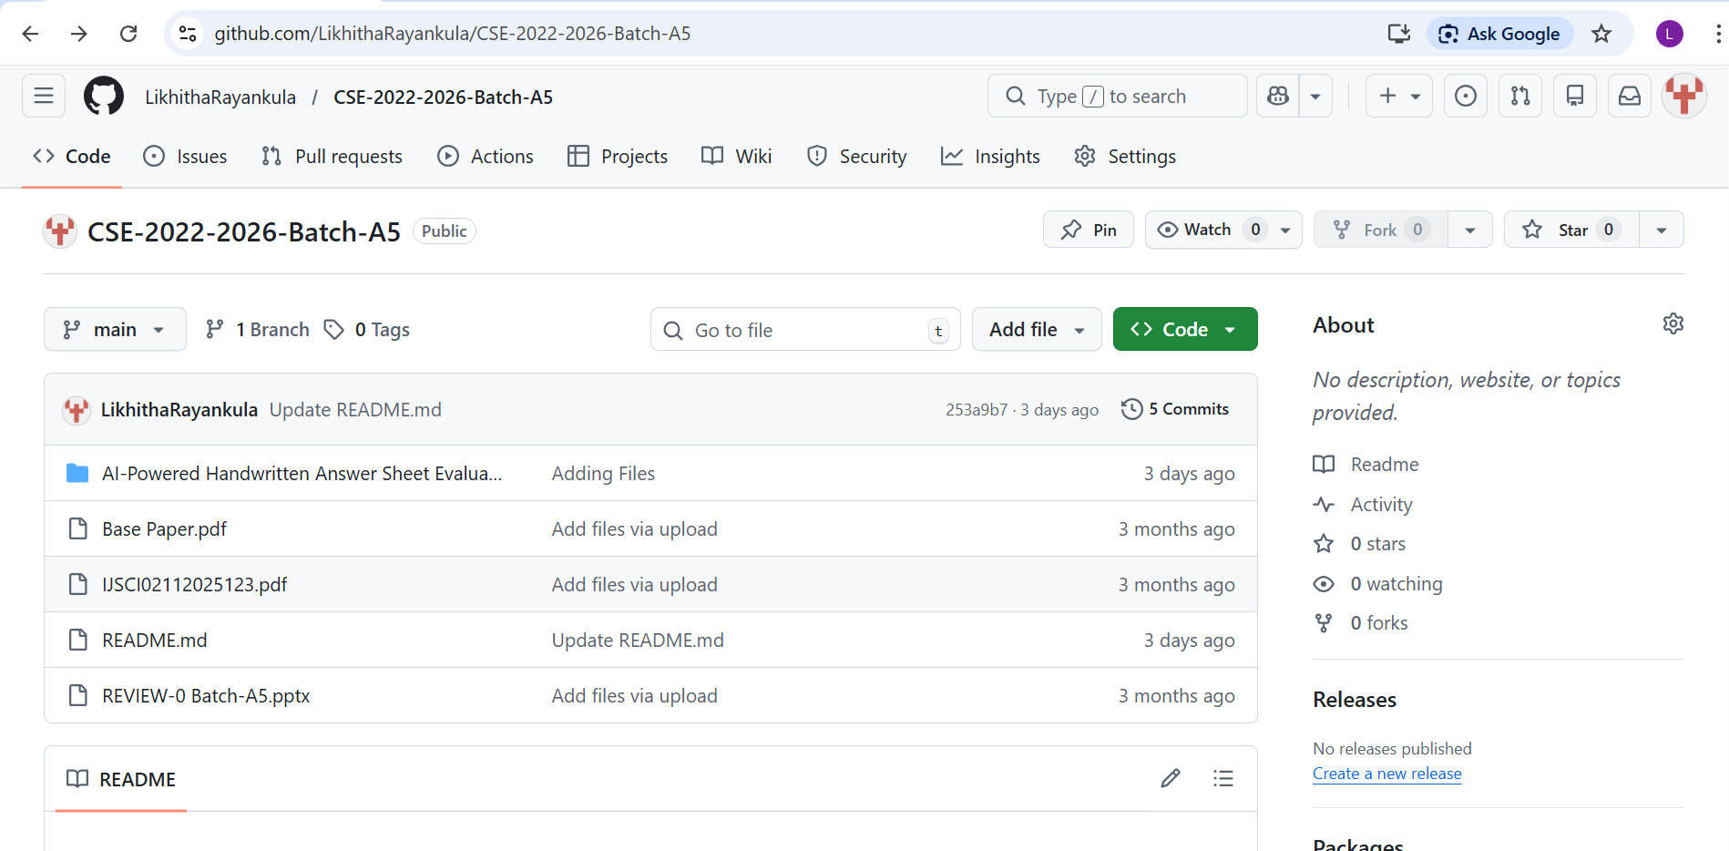
GitHub Link

Slide 21
Thank You!!!

Slide 22
Any Query?

